Slide 1



THE INFORM PROJECT
DeShaun Riddick

Slide 2

About Us
INFORM
Encompasses a network of east-west highways and north-south connectors, including the Long Island Expressway.
INFORM monitors traffic conditions using some 3,300 electronic sensors embedded in roadways at half-mile intervals.
INFORM
Is a company that is based in the New York, Hauppauge area. The organization has 100+ employees. The New York State Department of Transportation’s (NYSDOT) information FOR Motorists (INFORM) is a traffic management system that covers Long Island’s 60-mile central corridor.

Slide 3

Covid-19 Challenges
The Pandemic
The COVID-19 Pandemic has made working from home a challenge
Upgrading the infrastructure will give the company options to comply with guidelines from the CDC and governor’s initiatives for cyber security
The maximum occupancy in the Control Room is 60
We will plan for 50 occupants
INFORM
research

Slide 4

Need for Enhancements
            Upgrading to Laptops
            Choosing VMware
Plan

Slide 5
Infrastructure Upgrades
Procurements
Products
Competitive Benefits
Vostro 7620 and Inspiron 16 Laptop
VM ware from Horizon and Google Cloud for the Virtual Machine or Amazon
CBL (computer-based learning) programs
Anchor locks on the laptops
50 laptops from DELL for the Vostro 7620 will cost $949.00 per device
VM Ware from Horizon or Google is another option to entertain virtual machines for remote workers
The monthly fee is $12.50 per month and for the year it is $150.00
Kensington Laptop locks $40.00 totaling to $2,000.00 for a 50 count
INFORM research

Slide 6

C-Level Decisions
Informing of the enhancements
Options
Human Capital
Chart

Slide 7
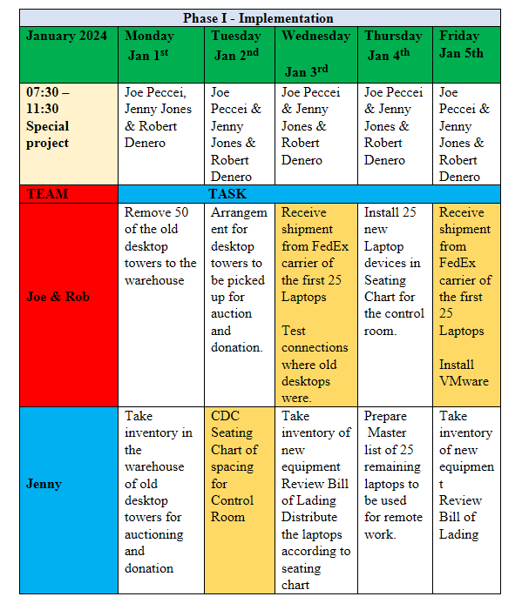
Human Capital
ASSEMBLING A TEAM
Scheduling
Assignments
Shipping & Receiving
Auctions and or Donations of old assets

Slide 8

title
(CBL) COMPUTER BASED LEARNING
Staff Meeting

Slide 9

Thank You
PHASE I
631-416-8422 IT DEPARTMENT
ROBERT DINERO/JOE PECCII & JENNY JONES
NETWORK MANAGER DESHAUN RIDDICK
END

